Slide 1
Trees of Jefferson County
Research example using project data
Victoria Myers

Slide 2
Trees – 1730’s

Slide 3
Trees -1750’s

Slide 4
Trees – 1760’s

Slide 5
Trees – 1770’s

Slide 6
Trees – 1790’s

Slide 7
Trees – 1800’s

Slide 8
Trees – 1820’s

Slide 9
Trees – 1830’s

Slide 10
Trees -1890’s

Slide 11
Trees – Over time

Slide 12
Number of trees over time

Slide 13
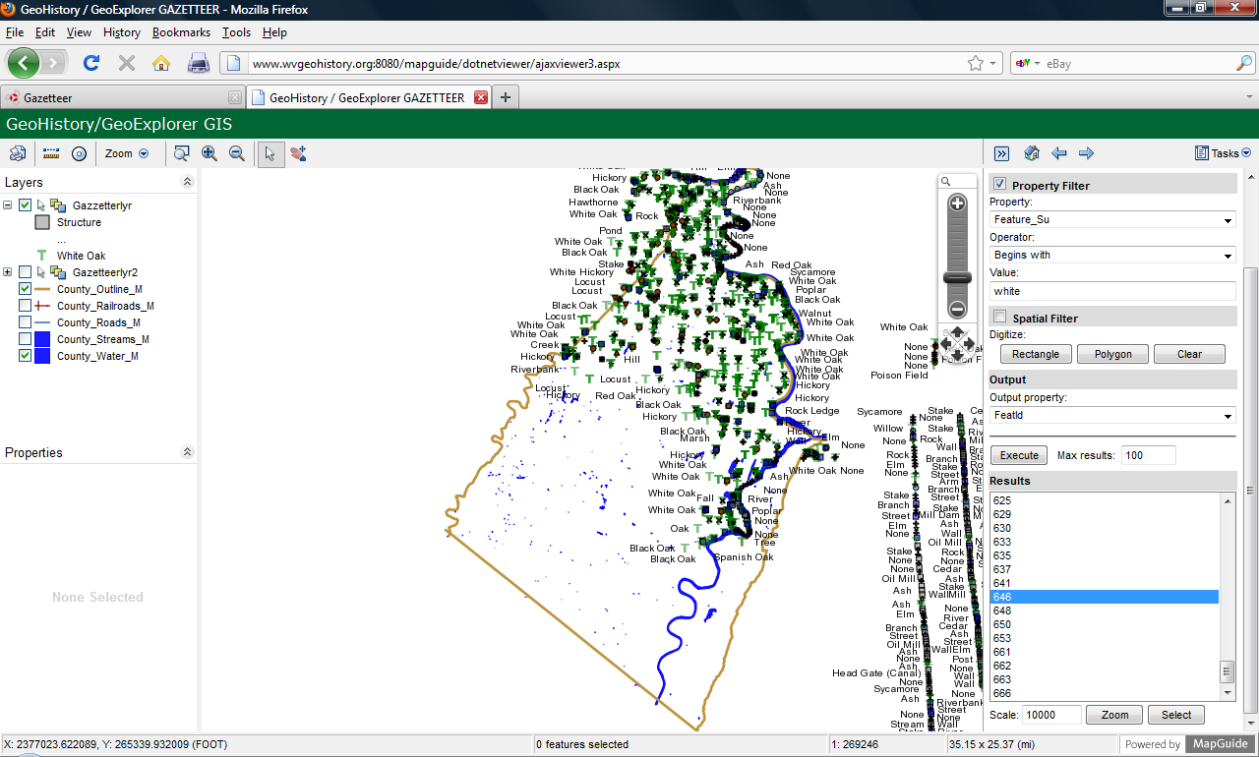
Online GIS

Slide 14
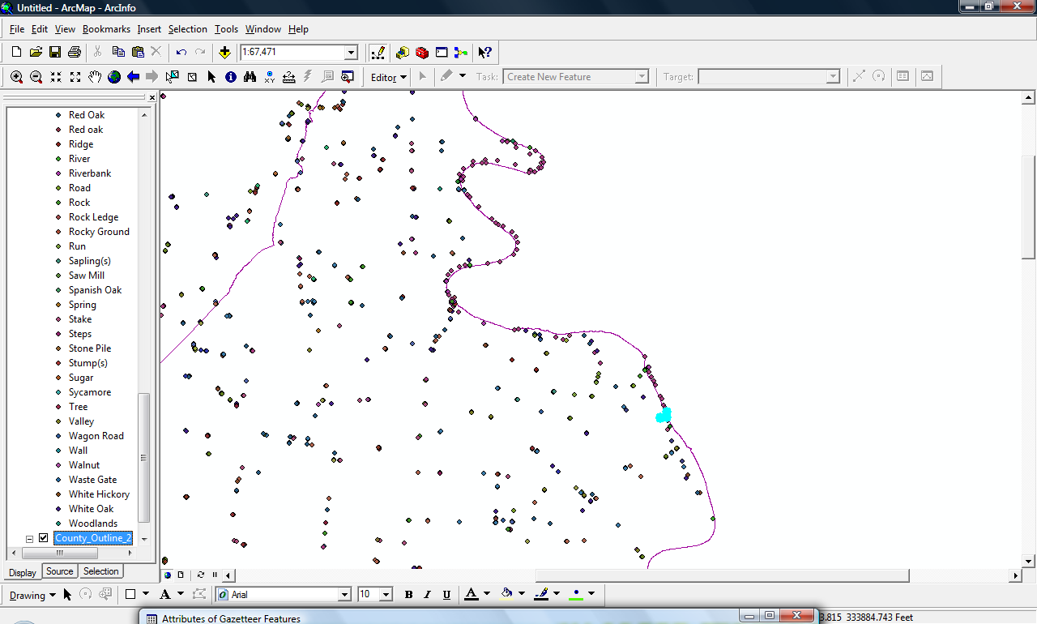
GIS Analysis

Slide 15
Problems/Issues
Data is random in nature and limited to property boundaries but most likely the best data available
Was the surveyor good at tree identification?
Surveyors tend to choose a tree with good longevity for corners.
Data skewed to the 1750/60’s due to the number of grants during that time

Slide 16
Conclusions/Insights
Area was most likely a mature forest
Non-native species begin to show up near population centers (cities)

